Slide 1
Empowering your Skills with Viya for Learners

Slide 2




1966
1976
Statistical Analysis System (SAS) project in NC State agricultural department supported by NIH analyzing effect of soil, weather, etc. on crop yield
Incorporated as SAS Institute (4 employees)

Slide 3
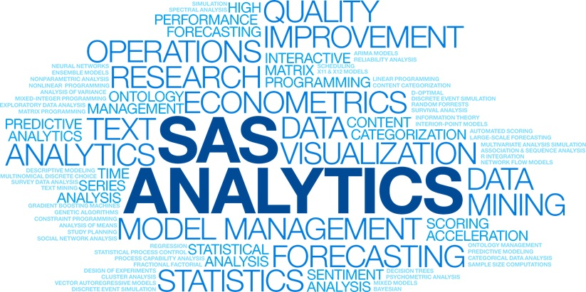
The Story of SAS
SAS | The Power to Know
For 40 years SAS has been a leader in the field of advanced analytics.
Our origins trace back to a small group of NC State professors focused on a single question:
“Is there a better way to analyze data?”

Slide 4
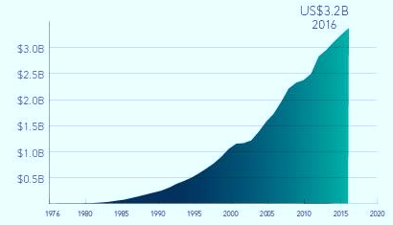





Today
US$3.3B
2018
#1
World’s largest privately held software company
14,000+
Employees
Serving
96
of the top
100
GLOBAL
500
COMPANIES
146
Customers in
countries

Slide 5
Why Learn SAS?
Analytics is key to solving today’s business problems.
Organizations are often collecting data at a faster rate than they can handle and need people who can make sense of the data.
A career in analytics is a smart choice.
People with an analytical skill set are highly sought-after. By acquiring the analytical skills organizations are looking for, you will differentiate yourself.
SAS can help boost your career.
Expand your career opportunities with SAS® skills and become an analytics expert. With SAS® certification a whole new world of opportunities will be open to you.

Slide 6

SAS Skill Leads to More Jobs
2019
2020
2021
2022
Number of USA Jobs Requesting SAS Skill

Slide 7
Top Companies Hire SAS Talent
United States (thousands)
Georgia
Job Postings In 2022

Slide 8
No-cost resources
SAS Software
Educator & Student
Training
Academic Support
SAS Specializations
Software for
teaching and learning
Custom workshops and
access to training materials
Curriculum consultation to support integration of analytics into the classroom
SAS Specializations highlight SAS skill through digital badges and credentials
Notes:
To do this our team offers free software, training and educational resources. Our free software for learning is available through two platforms SAS OnDemand for Academics and SAS Viya for Learners software. Our training is available virtually and onsite for both faculty and students. Both students and faculty also have access 24/7 to eLearning to bolster skills and learn new material. In addition to software and training, our team offers curriculum consulting and support for faculty interested in or already teaching SAS. You can access most of these resources through our two newly redesigned resource platforms: the SAS Educator Portal and SAS Skill Builder for Students.
We have free software for teaching and learning such as SAS on Demand and Viya for learners.
We also have training for faculty, so you strengthen your knowledge of SAS programs. These training may include customized workshops and access to training materials.
One of my favorite resources is Academic Support, which includes teaching kits, classroom activities, and curriculum consultation to support the integration of analytics into the classroom.
We also offer SAS specializations, which highlight SAS skills students have learned through academic courses through digital badging.

Slide 9
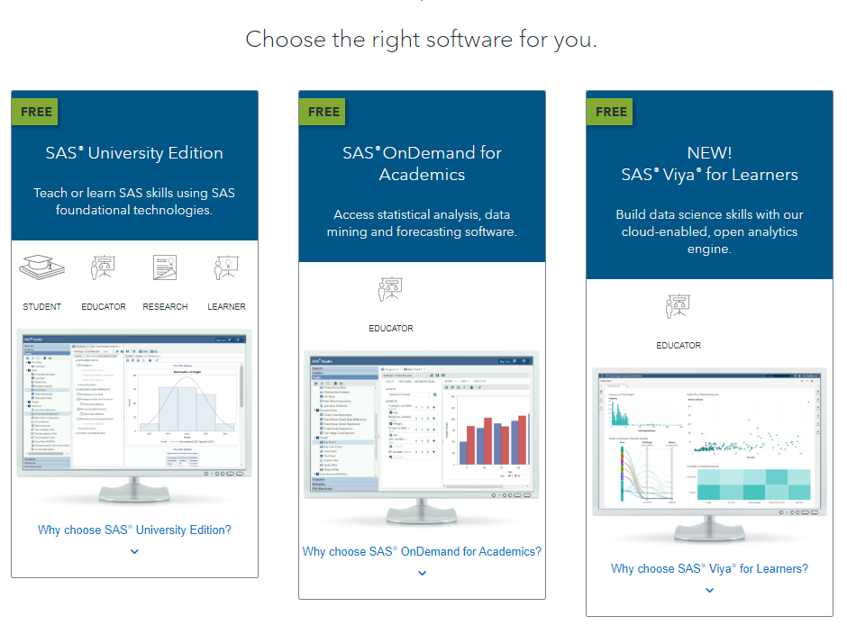
SAS Learning Software
Features:
SAS 9 tools: SAS Studio by default
Quick startup from a web browser
Cloud access from global server network
5 GB cloud storage (additional 3 GB for Educators)
Access to e-learning
Create courses with shared data
Get started in 4 easy steps:
Create a SAS Profile
Register for SAS OnDemand for Academics
Activate by email
Log in to ODA welcome page
Notes:
ODA Overview: https://www.youtube.com/watch?v=tmL8fdOd-pI

Slide 10


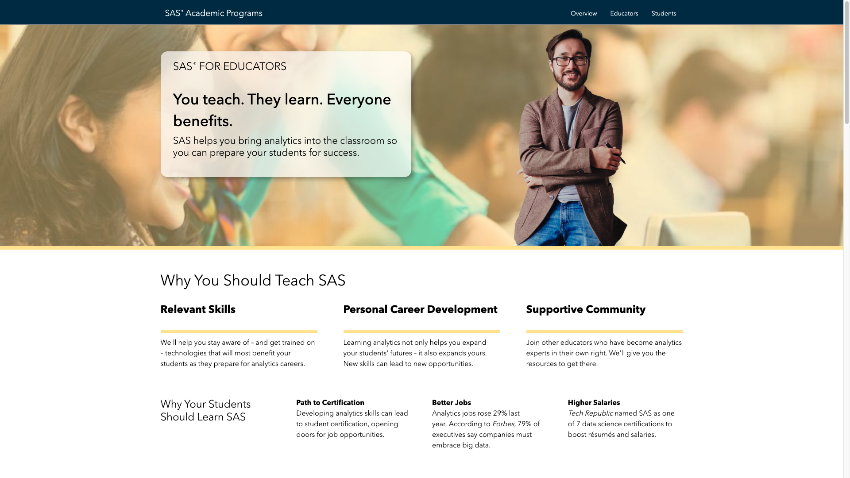
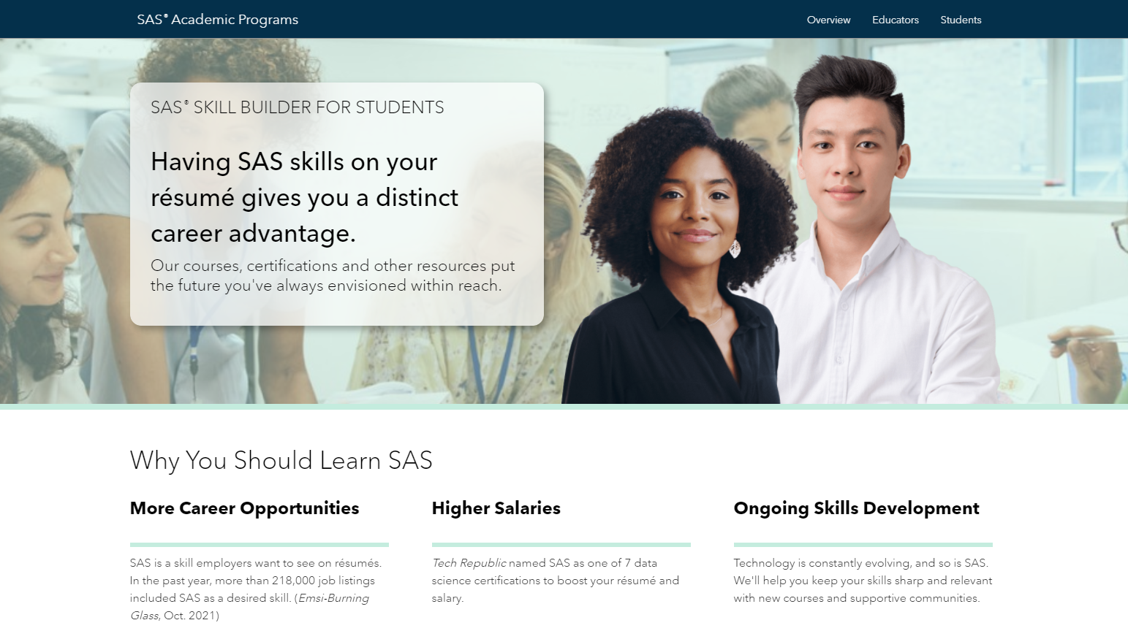
SAS® Educator Portal & Skill Builder for Students
Instructional materials for course development
E-learning and educator workshops
Certification preparation and discount
Skill development
E-learning
Certification preparation and discount
Notes:
Educator Portal: http://www.sas.com/en_us/learn/academic-programs/educators.geo.html
Skill Builder: www.sas.com/skillbuilderforstudents
Educators have access to all of the resources available in Skill Builder within the Educator Portal PLUS access to teaching materials including PowerPoint presentations, assignments and content guides. However, educators can access SAS Student for Skill Builder if they’d like to see the front facing platform their students will be working with. Educators and faculty can have access to both platforms. If you want your students to use Skill Builder to access resources, you can login to get a sense of what they’re seeing and use it to guide any course content development.

Slide 11
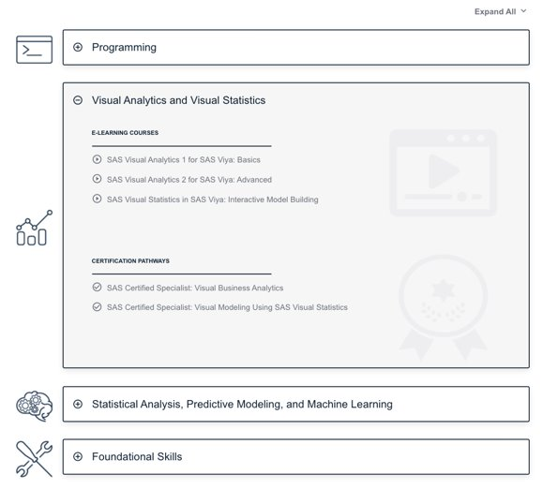
Learn SAS
Teaching Kits + e-Learning
Point-and-Click Analytics
Programming
Visual Analytics
Visual Statistics
Statistical Analysis
Predictive Modeling
Machine Learning
Data Literacy

Slide 12
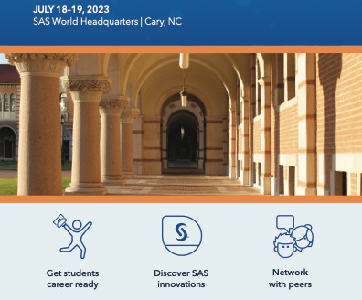
Summer 2023 SAS Educator Conference
sas.com/educator-conference23
This event brings together educators shaping the future of analytics for:
interactive discussions
software instruction
panels
and more!
Conference registration is free!

Slide 13
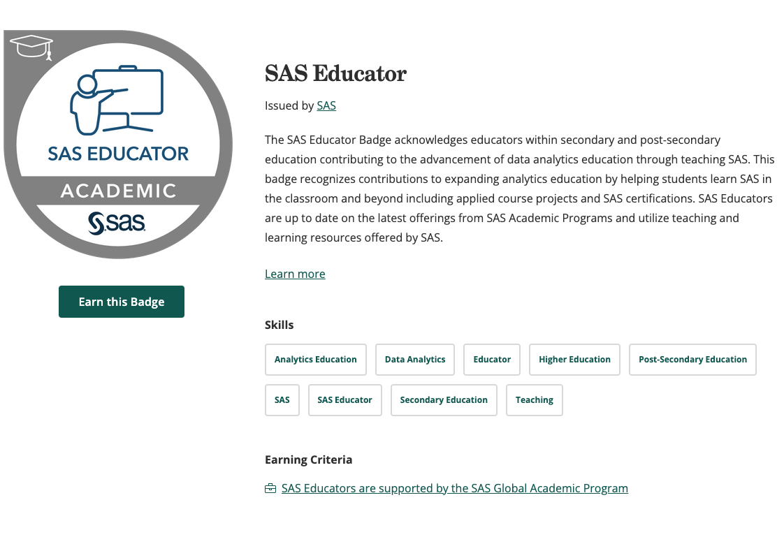
Claim a SAS Educator Badge
Notes:
Don't forget to claim your Educator Badge. If you are teaching with SAS or support students projects or co-curricular learning using SAS, you've earned it! Remember, it may take 24 hours to receive information from Credly once you submit your claim form. sas.com/educatorbadge

Slide 14
Why Viya for Learners?

Slide 15

cloud
enabled
modern analytics
in-memory engine
open source
standard SAS code
Notes:
SAS Viya is the latest enhancement of the SAS Platform.
It is cloud enabled, allowing scalable, web-based access for your particular data processing needs.
It includes an in-memory engine and parallel processing capabilities that can have a big impact on execution speed.
Familiar SAS code that you are accustomed to writing in SAS®9 will still work in SAS Viya. However, with a few modifications, you can take advantage of the in-memory processing in SAS Viya for accelerated performance.
It provides integration with open-source tools like Python, R, and other open-source languages.
Together, these features in Viya provide a modern analytics platform that can take you from data access and preparation to relevant, actionable results.

Slide 16




SAS Viya Servers
SAS Compute Server
SAS Cloud Analytic Services (CAS)
Executes traditional SAS®9 code
Executes CAS-enabled code in parallel on in-memory data
Notes:
SAS Viya includes multiple servers to execute SAS code. The two primary servers are the SAS Compute Server and SAS Cloud Analytic Services, or CAS. You can think of the SAS Compute Server as equivalent to the SAS®9 workspace server. Your familiar SAS®9 programs can be submitted as is to SAS Viya, and by default they will run on the Compute Server. There is no need to learn new syntax to use the Compute Server.
SAS Cloud Analytic Services is the high-performance server that allows for parallel processing on in-memory data. It is likely what you will use for your big data and complex analytics. Often, only very minor code modifications are required for programs to run in CAS. Learning how to write or modify SAS programs to run in CAS is the focus of this course.

Slide 17




SAS Viya is truly open
Java
API
Lua
CAS
Notes:
Finally ➔ SAS Viya was designed with open-source in mind!
Think about the timelines
Base SAS + EM designed before open-source was a thing
So they had to retrofit
SAS Viya makes it a lot easier for open-source coders

Slide 18
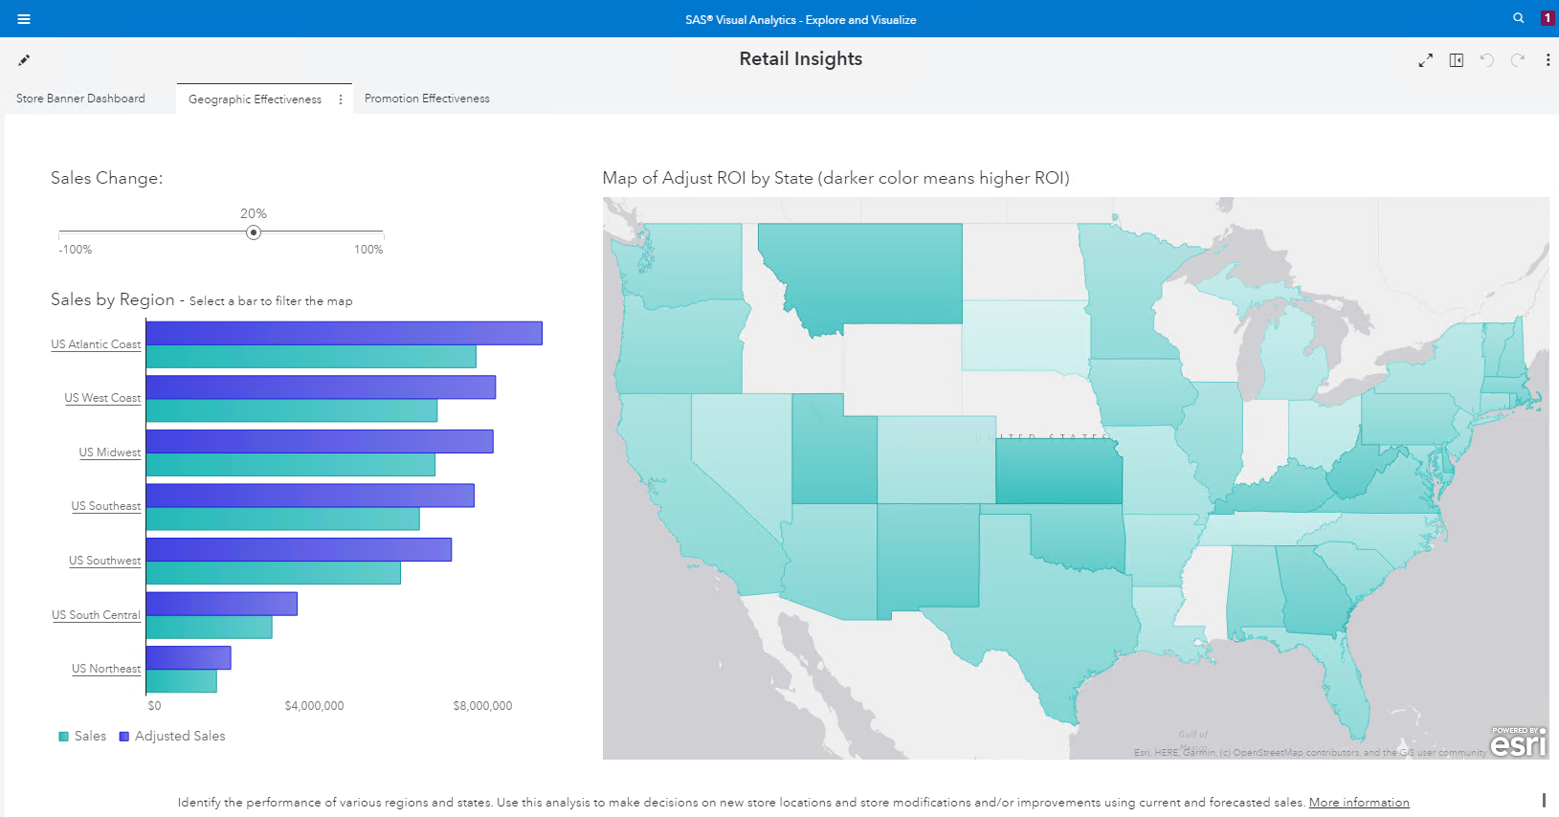
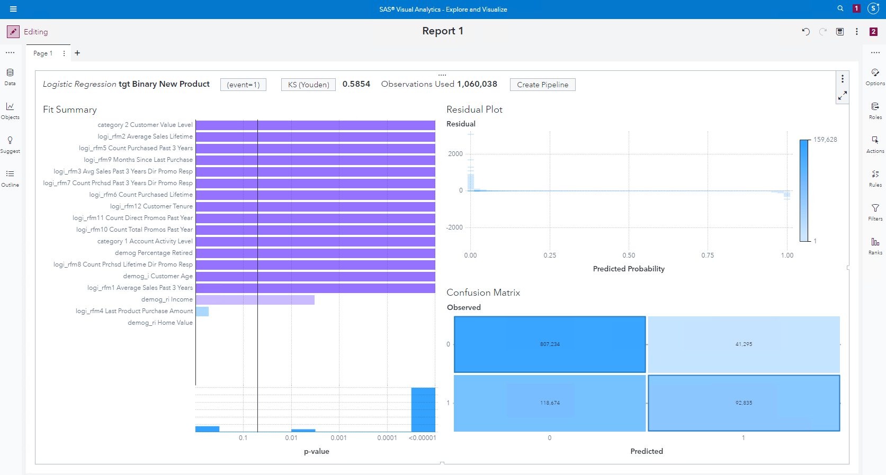
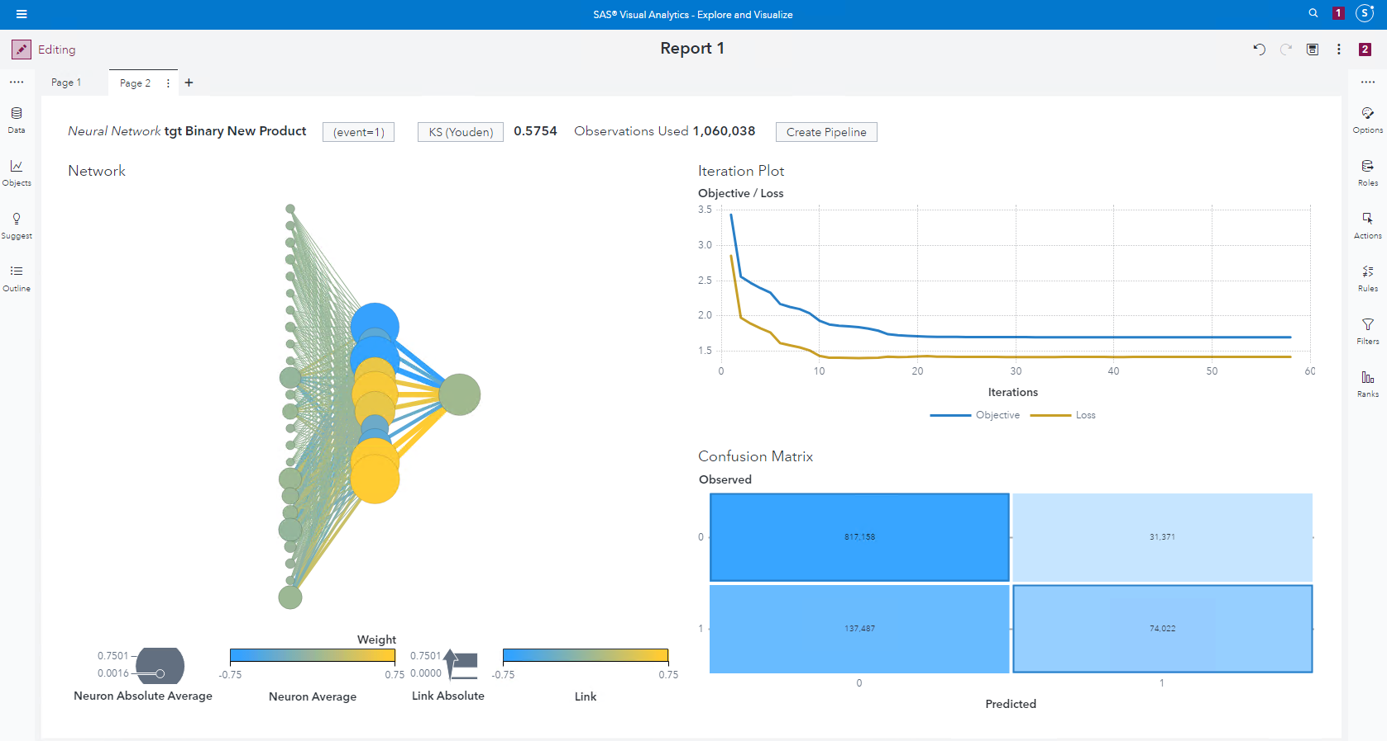
SAS Viya Functionality
SAS Visual Data Mining and Machine Learning
Six additional machine learning models
SAS Visual Analytics
Explore data and discovery relationships
Examine distributions and summary statistics
Perform post-model analysis and reporting
SAS Visual Statistics
Build unsupervised and supervised models
Interactively refine candidate models
Compare models and generate score code
Notes:
SAS Visual Analytics provides easy-to-use data discovery, analysis and visualization capabilities. Even novices can explore and analyze business-critical data without assistance, and then distribute dynamic dashboards to others. The interface provides interactive graphics, as well as autocharting capabilities that help new users choose the best visualization for their data. It’s easy to generate analytical visualizations, interactively filter data, format variables, add ad hoc calculated columns and create dynamic hierarchies without the need for predefined dimensional data structures.
SAS Visual Statistics is an interactive modeling tool that can be added to SAS Visual Analytics for increased predictive analytical power. The modeling capabilities of SAS Visual Statistics are included within the common user interface of SAS Visual Analytics Explorer. This means users can explore data and create models from the same, easy-to-use environment. By combining these two products, you get an in-memory platform that provides self-service data exploration and visualization and powerful descriptive and predictive analytics.
With SAS Visual Statistics, users can iteratively create their descriptive and predictive models. They can refine models in seconds to find the one that produces the best results – in near-real time. It’s really that easy. SAS Visual Analytics can be used before model development to explore data and after development to explore the model’s results. This can help reduce latencies during the iterative model development process.

